Slide 1
CMP203 Graphics Programming
Depth Sorting and Transparency

Slide 2
This Week
Depth Sorting
Z-buffer
Skybox
Alpha blending

Slide 3
Rasterisation
Last stage in Graphics Pipeline
Takes all information from previous stages and assigns a colour to each pixel in the frame buffer
Geometry
Vertex colours
Textures
Lighting
Essentially creating a 2D picture of our 3D scene object by object

Slide 4
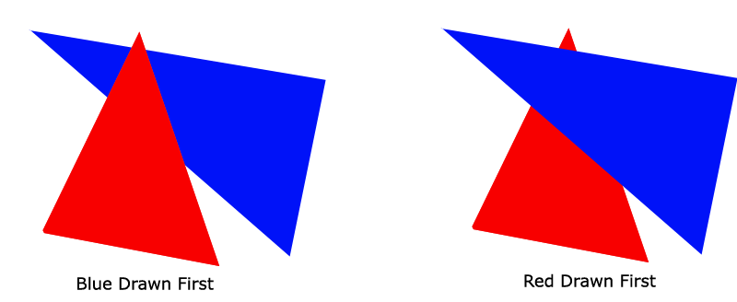
Depth Sorting
Rasteriser also decides if an object is drawn over another
With no depth sorting the drawing order is vitally important

Slide 5
Depth Sorting
How can we create a 3D scene with the depth preserved?
Manually specify drawing order
Fine for simple games
Complex / Dynamic scenes unworkable
Commonly used for 2D rendering
Create and maintain a list of objects positions in the scene and use this to dictate the drawing order
Solves the problem
Potentially complex to code / debug
Expensive computationally to maintain
Thankfully, there is already a solution

Slide 6
Depth buffer
Also referred to as Z-buffer
Industry standard, universally implemented in graphics hardware
Area of graphics memory identical in resolution to the frame buffer (1 value for each pixel)
Whenever a pixel is rendered to the frame buffer, a corresponding value is set in the Z-buffer describing the depth of that pixel in the scene
Whenever a pixel with a depth value is attempted to be overwritten, a depth test is performed
Is the pixel we are creating ‘closer’ than the value in the z-buffer?
If so create the new pixel
Store the new depth value

Slide 7
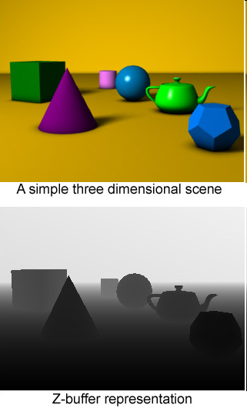
Z- Buffering

Slide 8
Z- Buffering
Precision
Z-Buffer has a limited precision, Typically a 16-bit or 32-bit depth value for each Pixel
If we need more precision then we must allocate more memory to the z-buffer
Z-Buffer has to try to track every possible position between the near and far planes of the frustum
The larger the view distance, the more inaccurate the z-values become
Z-fighting
Non-Linear distribution of Z-precision
Close objects – higher Precision
Far objects - less precision

Slide 9
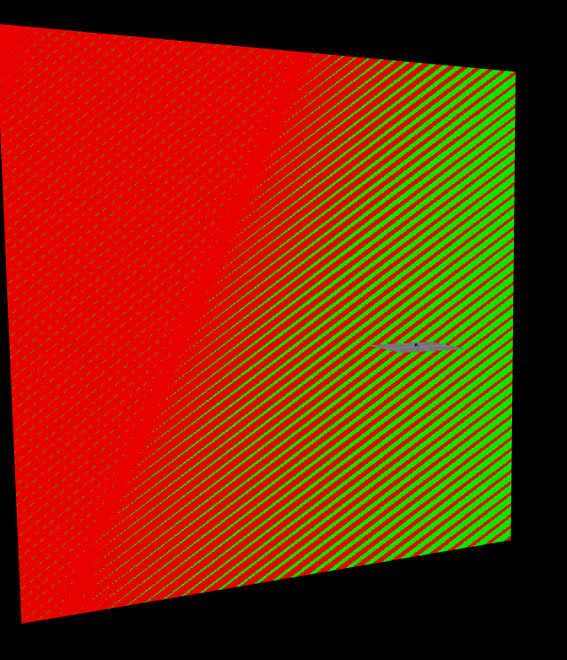
Z fighting

Slide 10
OpenGL
Depth Test settings:
glDepthFunc(GL_LEQUAL);
Other settings
GL_ALWAYS, GL_LESS, GL_EQUAL, GL_GEQUAL, GL_GREATER, GL_NOTEQUAL
Depth buffer clearing
glClear(GL_COLOR_BUFFER_BIT | GL_DEPTH_BUFFER_BIT)

Slide 11
OpenGL
Enabling depth testing
glEnable(GL_DEPTH_TEST);
Sets an the OpenGL rendering state, so we can turn it on and off whenever we like
Why might it be useful to turn off the depth buffer?
Drawing objects that we NEED to be in front of everything else
HUD objects etc
We are then back to the problem of doing our own depth sorting

Slide 12
Depth testing example
Scene() constructor
glEnable(GL_DEPTH_TEST);
glDepthFunc(GL_LEQUAL);
render()
...
Color = red
DrawTriangle(0 on Z-axis)
Color = blue
DrawTriangle(-0.5 on Z-axis) Further away

Slide 13
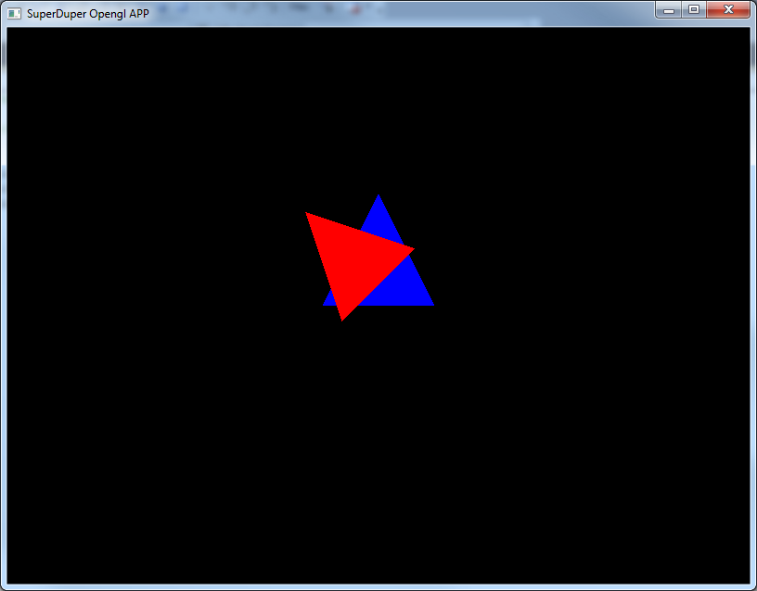
With depth test

Slide 14
Turn off depth test
render()
...
glDisable(GL_DEPTH_TEST);
Color = red
DrawTriangle(0 on Z-axis)
Color = blue
DrawTriangle(-0.5 on Z-axis) Further away

Slide 15
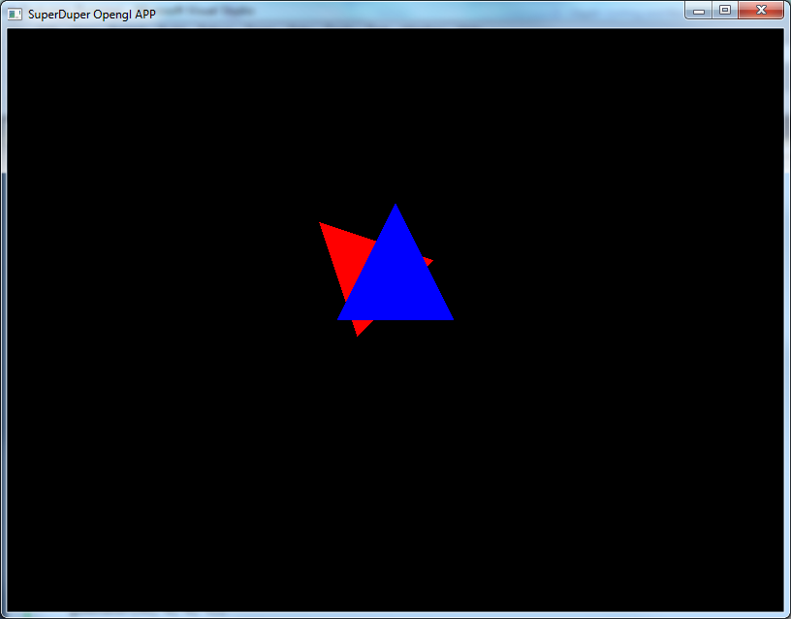
Without depth test

Slide 16
Using the depth test
Skybox
Why?
Looks nice, puts something in the distance
Makes our objects look like they aren’t just floating in space
Two techniques
GIANT box surrounding the whole scene
A small box surrounding just the camera + some depth sorting trickery

Slide 17
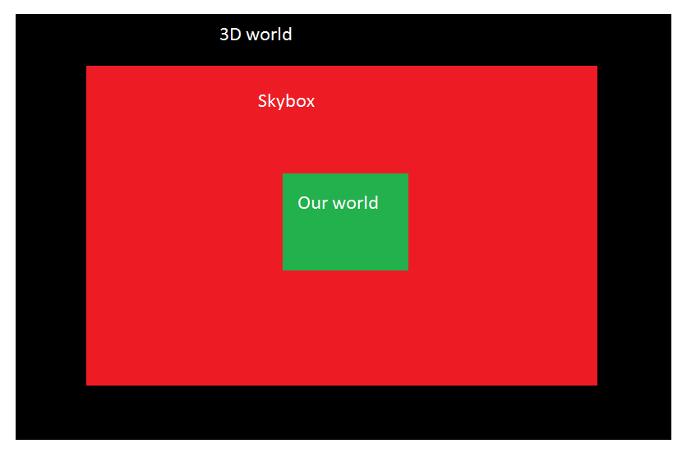
GIANT box technique

Slide 18
GIANT box technique
Works
Quite easy
BUT
Requires LARGE texture
The bigger the world, the bigger the texture
Given enough time, player could eventually walk to the skybox, breaking it
Doesn’t have to be a box (for either technique)

Slide 19
Depth test technique
Render a single unit cube around the camera
Move the box when the camera moves
The trick!
Turn off depth testing when drawing the box
DRAW THE BOX FIRST (right after the camera)
Advantages
Can’t ever reach skybox
Requires smaller texture, even for high detail
Doesn’t have to be a box
In both cases make sure you draw the skybox first!
Can also be used for HUDs and other on-screen displays

Slide 20
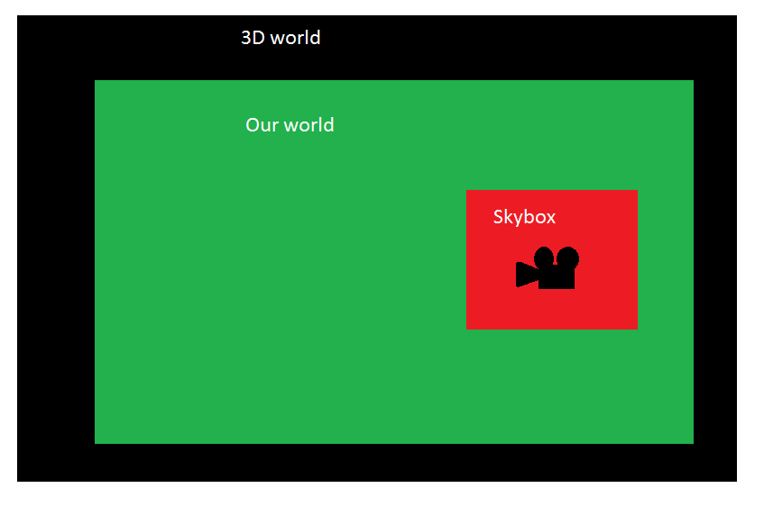
Paint shop skills

Slide 21
Example
Simple example
A skybox with sky texture
A crate in the middle of the scene
We will build something that will look like this…

Slide 22
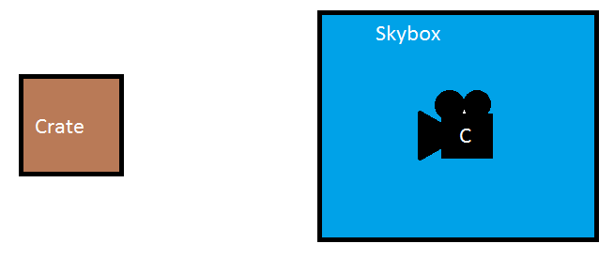
Skybox

Slide 23
Skybox pseudo-code
Select skybox texture
Push matrix
Translate to camera position
Disable depth test
Draw box
Enable depth test
Pop matrix
Draw rest of scene

Slide 24
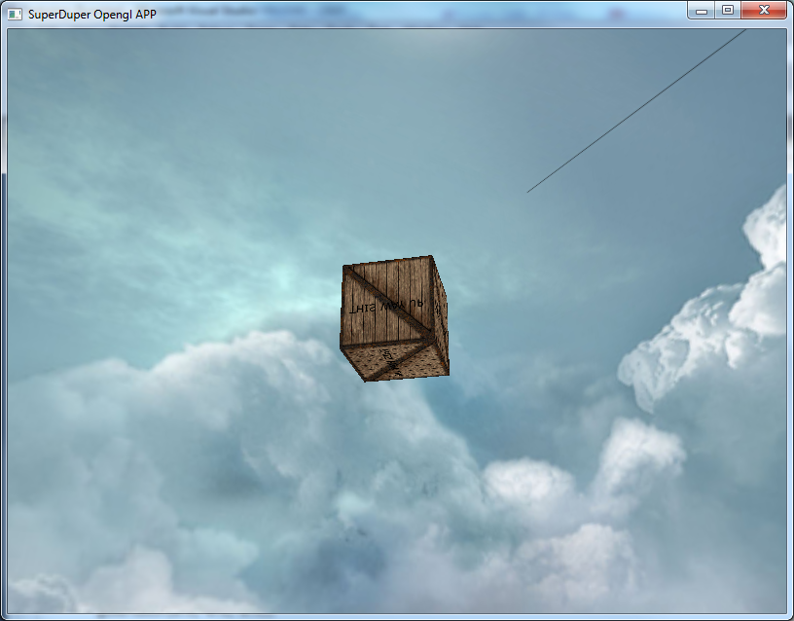

Slide 25
Other types
I mentioned a skybox doesn’t have to be a cube
Cube is most efficient
But not always the best
Alternatives
Sphere
Dome
Any shape really

Slide 26
Blending / Transparency

Slide 27
Blending
What is it?
Technique used in games that can give objects a semi-transparent appearance
Widely used in modern graphics
Transparent objects in games, glass, water etc
Brush effects in art packages
Alpha mapped partially transparent objects in games
Blending two surfaces together to obtain a multi-textured effect

Slide 28
Blending
Definition
Normally, when we write a pixel into the frame buffer, the rasteriser simply replaces the value for that pixel
When rendering a blended object, the pixel being rendered into the frame buffer is combined with the existing pixel
The way in which the new value is combined with the old is determined by the blending function used

Slide 29
Blending
The Alpha value
Used in OpenGL colour values as standard (RGBA)
This value is used by the blending function to create the new value
Often referred to as Alpha-Blending
Alpha range
1.0 a perfectly opaque object
0.0 a perfectly transparent object

Slide 30
Blending
The Blending Function
Parameters Considered
Source Colour (Transparent Object we are drawing)
Destination Colour (Pixel that already exists in the frame buffer)
Alpha Value of the source (how transparent is the object we are trying to draw?)
Source (RGBA)
Destination(RGBA)

Slide 31
Blending
The Blending Function
Source = (Sr, Sg, Sb, Sa)
Destination = (Dr, Dg, Db, Da)
OpenGL uses this function to compute the final colour
(RsSr+RdDr, GsSg+GdDg, BsSb+BdDb, AsSa+AdDa)
Looks terrible, but as usual with OpenGL, we do not have to deal with this function directly

Slide 32
Blending
The Blending Function
The function is in effect a Linear Interpolation of the colour values based on the Alpha
E.g. We wish to render a 75% transparent red object in front of a normal (Opaque) green surface.
Red*Alpha+Green*(1-Alpha)=Yellowish-Green
R 1 * 0.25 + 0 * (1 - 0.25) = 0.25
G 0 * 0.25 + 1 * (1 - 0.25) = 0.75
B 0 * 0.25 + 0 * (1 - 0.25) = 0.0

Slide 33
Blending
OpenGL Implementation
Turn on blending
glEnable(GL_BLEND)
glDisable(GL_BLEND)
Only enable when you are actually drawing your transparent object
Set the Blending Function
glBlendFunc(Glenum sfactor, Glenum dfactor)
Uses two constants that determine how the blending function does the calculation
Eg glBlendFunc(GL_SRC_ALPHA, GL_ONE_MINUS_SRC_ALPHA);

Slide 34
Blending
OpenGL Implementation
Setting the Alpha
Done with glColor4f()
Blend Constants
Full list in Red book(p167)
GL_Zero
GL_DST_COLOUR
GL_DST_ALPHA
15 in total
https://www.opengl.org/sdk/docs/man4/xhtml/glBlendFunc.xml

Slide 35
Blending
Rendering Blended Objects
Be careful with drawing order
Do your best to draw non-blended objects FIRST
Otherwise blended colours may not show through object
Non Blended objects will overwrite blended ones in the frame buffer

Slide 36
Blending
Drawing Order
Drawing order is critical for transparent objects
Order must be, furthest away first closest last
Think of the path the light must take to get to the camera
Differing the order will change the colour results of the blending and create artefacts
This means for a scene with moving blended objects it may be necessary to track their positions

Slide 37
Blending
Other uses
Anti-aliasing
Edges of polygons / Lines are given Alpha values and blended with colours behind them.
Is Supported in OpenGL (Red Book p175)
Fog
Colours are Blended with the Fog Colour based on their distance into the scene

Slide 38
Blend example
75% transparent red object in front of a normal (Opaque) green surface
Init()
glBlendFunc(GL_SRC_ALPHA, GL_ONE_MINUS_SRC_ALPHA);
Render()
glColor4f(0, 1, 0, 1); //green
drawQuad(); //draw a quad
glEnable(GL_BLEND); //disable blending
glColor4f(1, 0, 0, 0.25); //red
drawQuad(); //in front of other quad
glDisable(GL_BLEND); //this is IMPORTANT

Slide 39
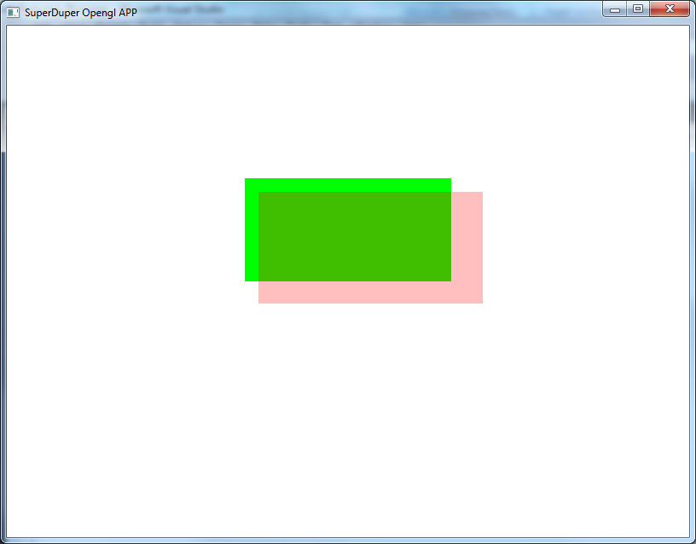
Results

Slide 40
Summary
Lab
A look at depth sorting
Creating a skybox
Creating transparent objects
Working with transparent textures
I will provide a few more test textures
Transparent textures and a skybox texture

